Slide 1
Products Service Delivery
Release & Deployment Management
Madhu Reddy Asst Release Manager
<Nov, 2019>

Slide 2
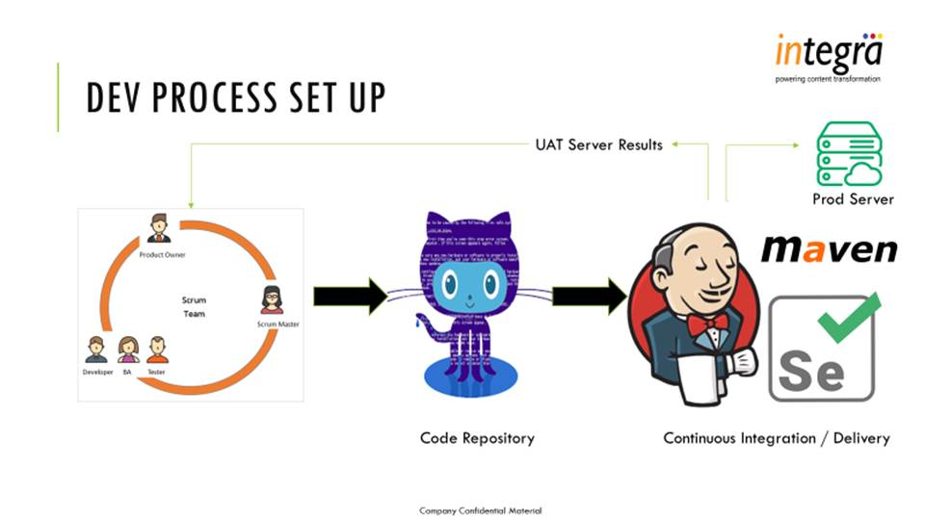

Slide 3
Post Actions for the CI/CD Automation:
Windows Jenkins server configuration setup has done.
Linux Jenkins server configuration setup has done.
Able to connect and clone the data from development code repository.
Able to test using automation script using Maven & Selenium.
By using node packages able to build and test the code.
Able to deploy the code into Azure app server.
Completed the CI/CD process for the iPMP project.

Slide 4
Milestone Review and Quality Gates - Checklist
Application Name | Development Env Estimation Date | Test Env Estimation Date | Demo Env Estimation Date | Regression Env Estimation Date | Production Env Estimation Date | Platform
iPMP | NA | 08-Nov-19 | NA | NA | 13-Mar-20 | Angular JS with Node JS
iLancer - T&F | NA | 08-Nov-19 | NA | NA | 13-Mar-20 | Angular JS ( Gulp Framework) , Web API
iLancer - Dove | NA | 15-Nov-19 | NA | NA | 13-Mar-20 | Angular JS ( Gulp Framework) , Web API
iLancer - Integra | NA | 15-Nov-19 | NA | NA | 13-Mar-20 | Angular JS ( Gulp Framework) , Web API
iRights | 15-Nov-19 | 15-Nov-19 | 07-Feb-20 | 07-Feb-20 | 20-Mar-20 | Node Js, React Js
ICMS | 22-Nov-19 | 22-Nov-19 | 07-Feb-20 | 07-Feb-20 | 20-Mar-20 | Node Js, React Js
ICMS-API | 22-Nov-19 | 22-Nov-19 | 14-Feb-20 | 14-Feb-20 | 20-Mar-20 | Node Js
iAuthor | 29-Nov-19 | 29-Nov-19 | 14-Feb-20 | 14-Feb-20 | 20-Mar-20 | Node Js
Pearson Searchable Video Collection | 29-Nov-19 | 29-Nov-19 | NA | NA | 27-Mar-20 | Node Js,React Js
Pearson Image Atlas | 06-Dec-19 | 13-Dec-19 | NA | NA | 27-Mar-20 | Node Js,React Js
devintegra-NLP | 06-Dec-19 | 13-Dec-19 | NA | NA | 27-Mar-20 | Node Js
iCorrectProof - T&F | NA | 20-Dec-19 | 21-Feb-20 | NA | 27-Mar-20 | MVC.Net,Jquery
iCorrectProof - DOVE | NA | 20-Dec-19 | 21-Feb-20 | NA | 03-Apr-20 | MVC.Net,Jquery
iCorrectProof - WKI | NA | 27-Dec-19 | 28-Feb-20 | NA | 03-Apr-20 | MVC.Net,Jquery
iCorrectProof - KLI | NA | 27-Dec-19 | 28-Feb-20 | NA | 03-Apr-20 | MVC.Net,Jquery
Wolters Kluwer Digital Book Platform | NA | 10-Jan-20 | NA | NA | 03-Apr-20 | MVC.Net,Jquery
T&F EDA scheduler | NA | 10-Jan-20 | NA | NA | 10-Apr-20 | ASP.Net, C#
devintegra-NLP-CS | 17-Jan-20 | 17-Jan-20 | NA | NA | 10-Apr-20 | C#
live-ispell2 | 24-Jan-20 | 24-Jan-20 | NA | NA | 10-Apr-20 | Java
live-ispell2-Python | 31-Jan-20 | 31-Jan-20 | NA | NA | 17-Apr-20 | Python
ICMS-DB | 07-Feb-20 | 07-Feb-20 | 06-Mar-20 | 06-Mar-20 | 17-Apr-20 | SQL Server

Slide 5
Milestone Review and Quality Gates.
DEV
TEST
QA
MONITORING
PROD

Slide 6
Pre-system configurations.
Required Linux (Centos/Ubuntu)Environment to setup the Jenkins server with free space of 16GB RAM & 1TB Hard disk.
Required windows applications, should enabled the FTP/SCP server ports for required drives/folders.
Basic software should be installed in the Jenkins server, listed in the excel.
Required monitoring tool as a Nagios.
Antifactory storage purpose required Nexus/S3/Azure Storage.
Server | Environment | RAM | Hard disk | Monitoring Tool | Artifactory Tool
Linux | Centos/Ubuntu | 16GB | 1TB | Nagios | Nexus/S3/Azure Storage

